Slide 1
Serenity Sage Wellness
Medical Health Appointment Booking Website
Presented By TEAM DEVIN
Name StudentID
Akash Mishra: S11219345
George Fong: S11220337
Shindu Chand: S11219903
Josifini Raiqiawa: S11219232

Slide 2
01
Introduction

Slide 3
Project Overview
Serenity Sage Wellness is dedicated to providing quality healthcare to patients over the past two decades.
They encourage preventative measures and are accessible to all
They also create awareness about Medicine, Science, and Technology and provide health tips to the community.
The clinic offers counselling sessions with experienced psychologists and has significantly improved patient quality of life.
They have developed an online site to address long waiting lines and improve services.
Their mission is to provide quality healthcare and contribute to community well-being without bias, and their vision is to address all needs without discrimination.

Slide 4
02
Content Goals

Slide 5
Content Goals
Primary Content Goal:
E-commerce website: users are able to book and pay for appointments online
Secondary Content Goal:
Blog Section: It provides users with health tips and informative articles such as,
i. Pregnancy Tips for Parents prenatal and postnatal
ii. Reproductive Health education and tips for teenagers
iii. Exercise tips for various age groups.
iv. NCD’s - This will be a broad section given the content to be covered.
v. Drugs, Substance Abuse and Suicides health tips and articles to users.
Special Interest: Serves as a special interest website to users from the content of the blogs given.

Slide 6
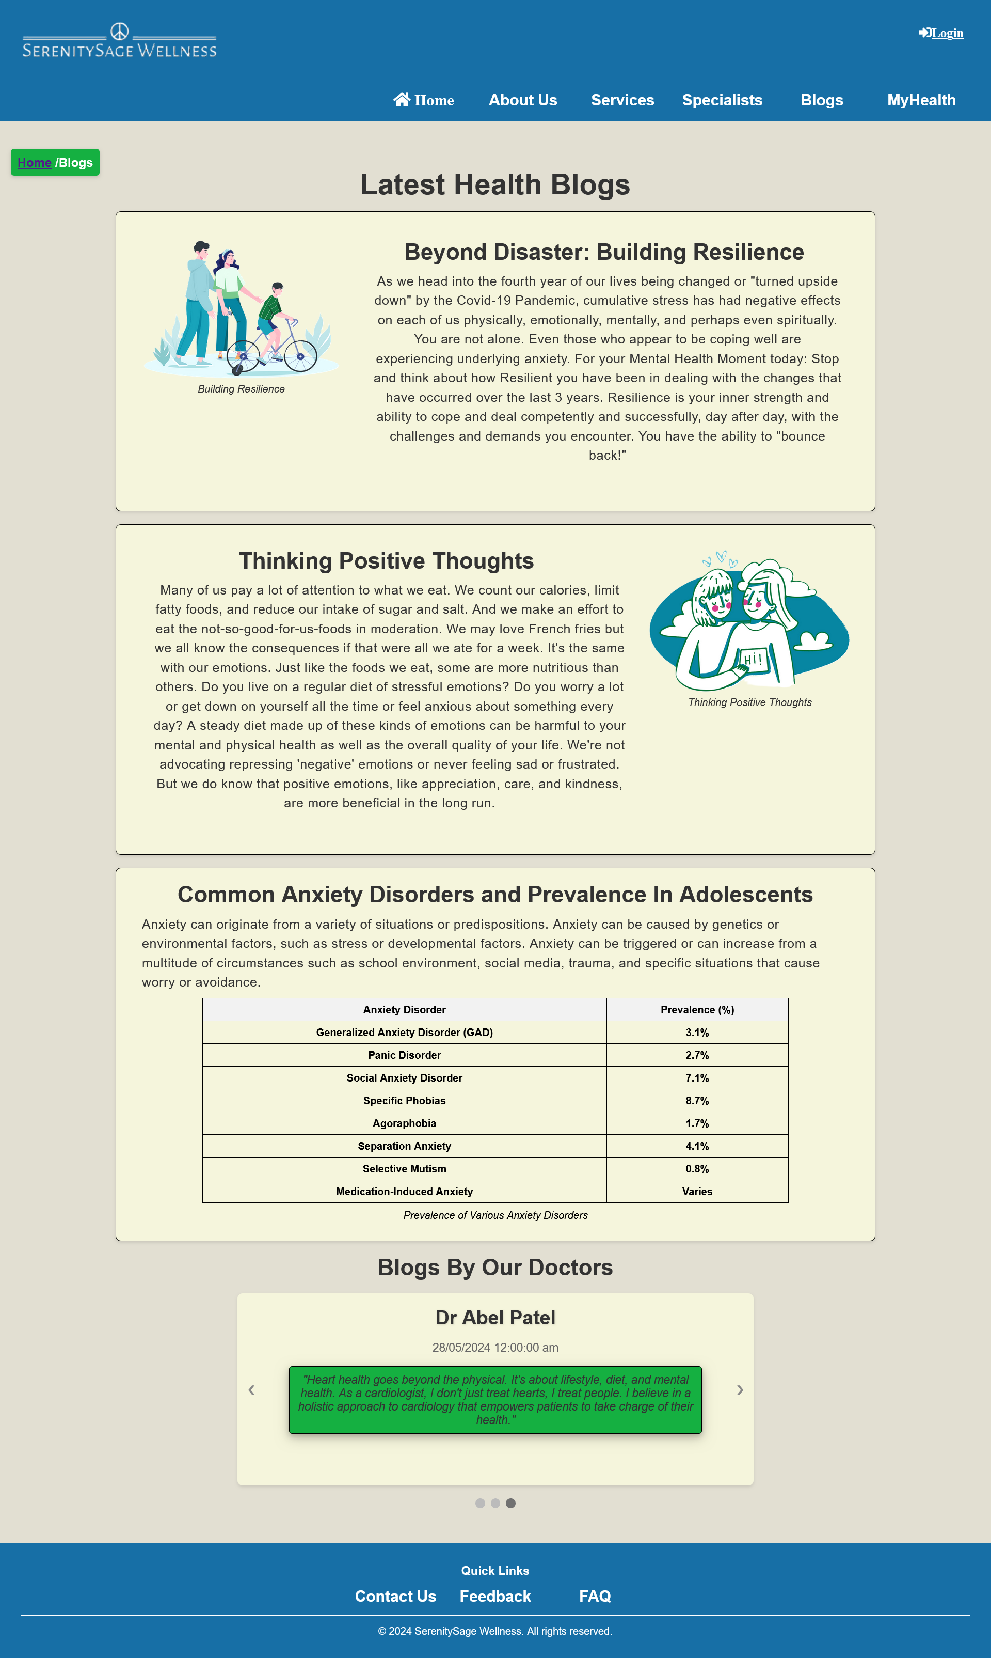
Screenshots

Slide 7
03
Audience

Slide 8
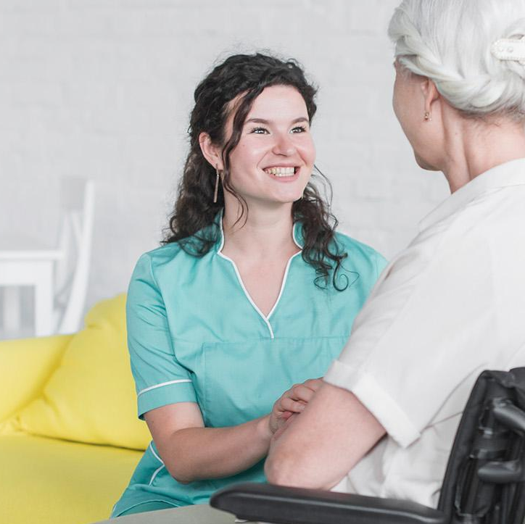
3.1 Target Audience
The target audience of Serenity Sage Wellness are:
- Patients (long and short term)
- New visitors
- Patients (long and short term)
- Health enthusiasts.
- Teenagers
The website is accessible to all genders and nationalities, catering to all age groups.

Slide 9
Continued
The website features content relevant to all genders, including exercise blogs for both males and females.
It is also offers accessibility elements for those with physical disabilities, such as visual and hearing impairments.
The website is accessible to electronic devices such as laptops, personal computers, mobile phones, and smart TVs

Slide 10
04
Site Content and Functional Requirements

Slide 11
4.1 What pieces of content does the site offer?
Home page: A brief introduction to the clinic, appointment bookings and the latest health blogs. It gives a general overview, grabs user attention and motivates exploration
About Us page: It shows detailed information on the clinic’s mission, vision and team profiles. This builds trust and transparency allowing users to connect with the website
Services page: A drop-down menu showing information on the clinic’s services, like checkups or blood tests. It informs users about what the clinic offers.
Blogs: This page provides articles with health tips and advice. This encourages user engagement
Contact Us: Contact details of the medical clinic such as email, phone number, and social media links. Allows users to reach out with queries.
FAQ: This section is aimed at answering common questions by users regarding
the use of the website

Slide 12
4.2 What sorts of functionality are provided?
Login Bar: Secure access for registered users.
Online Appointment Booking: Core functionality for appointment scheduling.
Appointment Cancellation and Rescheduling: Allows users to cancel or reschedule appointments.
Appointment Viewing: Enables viewing of appointment details
Password Change: Enables user password changes for security.
Review System: Allows patients to post reviews
Blog Posting: Enables doctors and content managers to publish content.

Slide 13
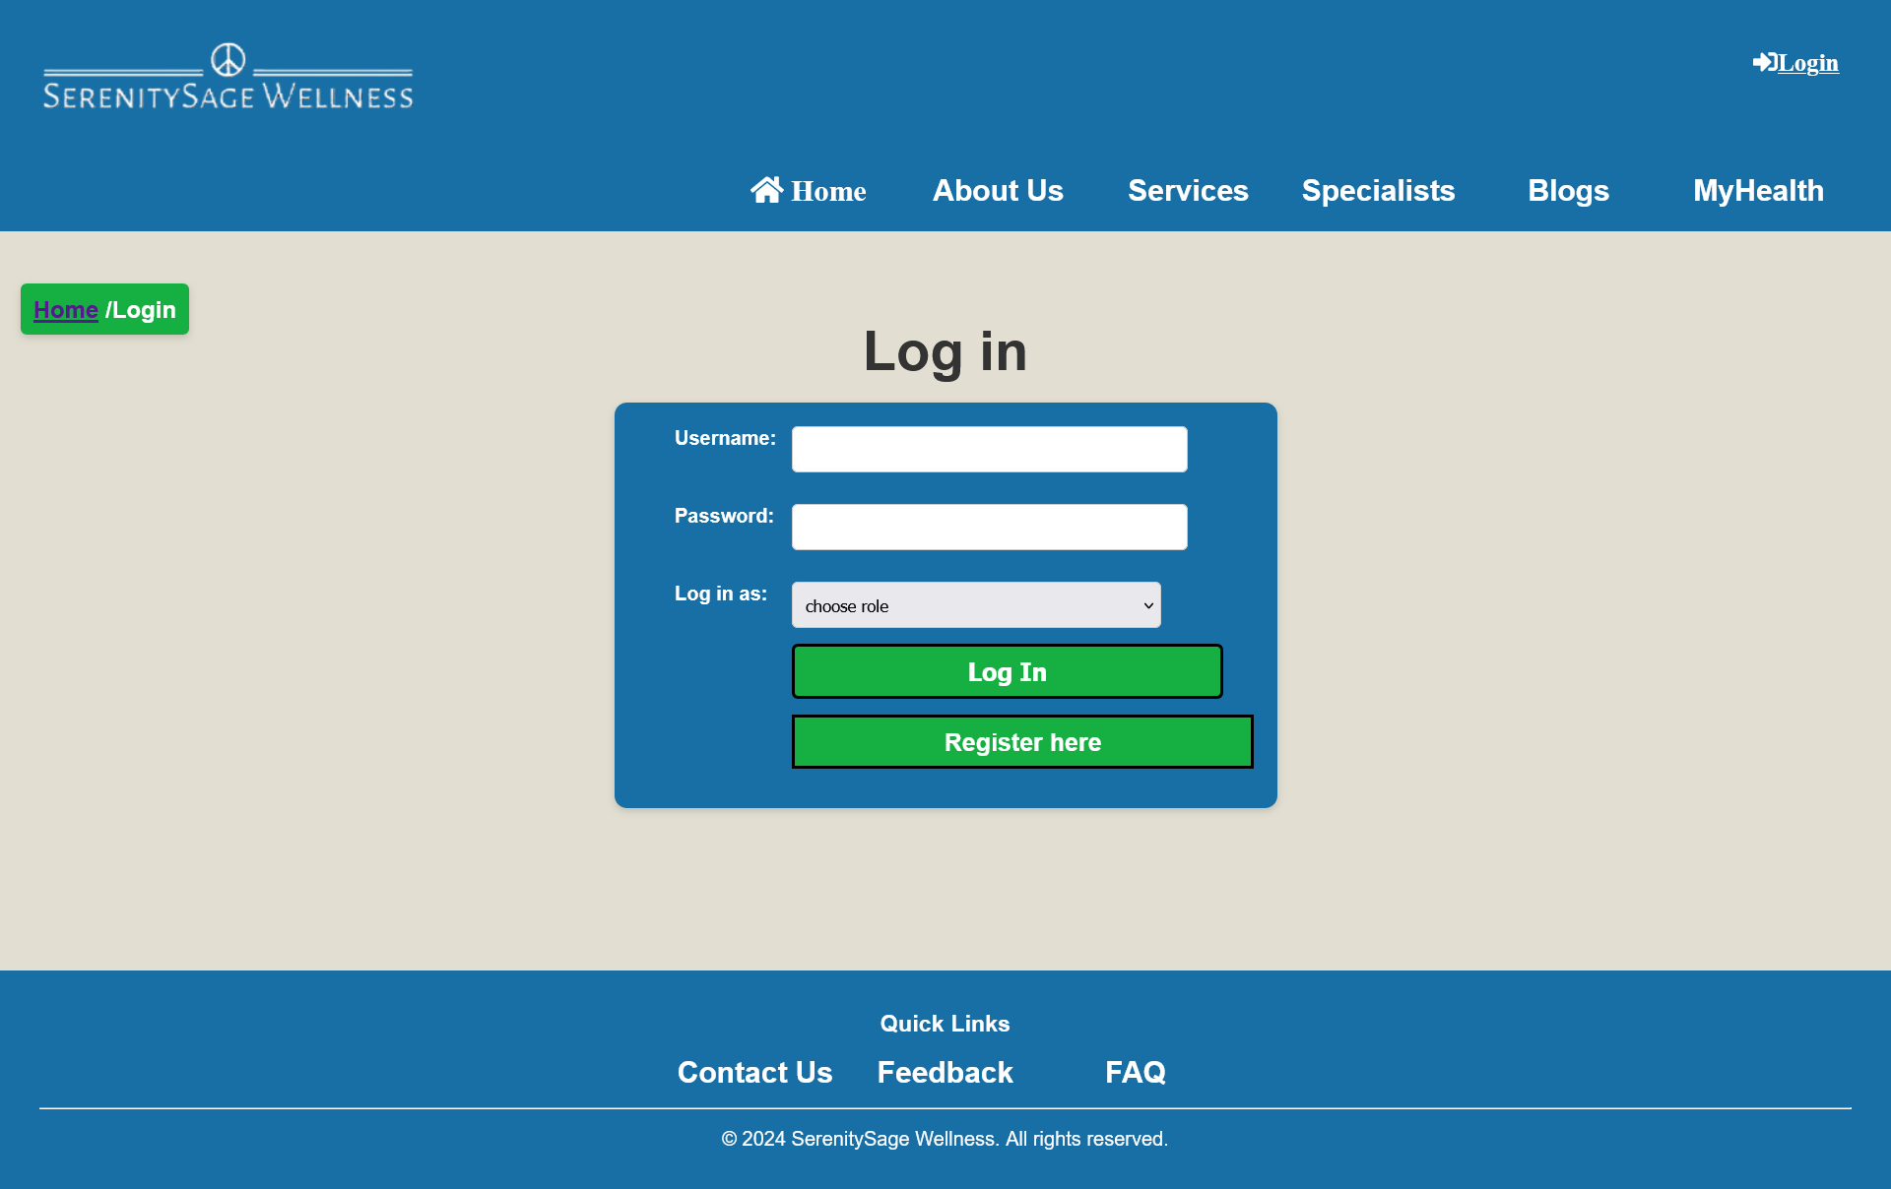
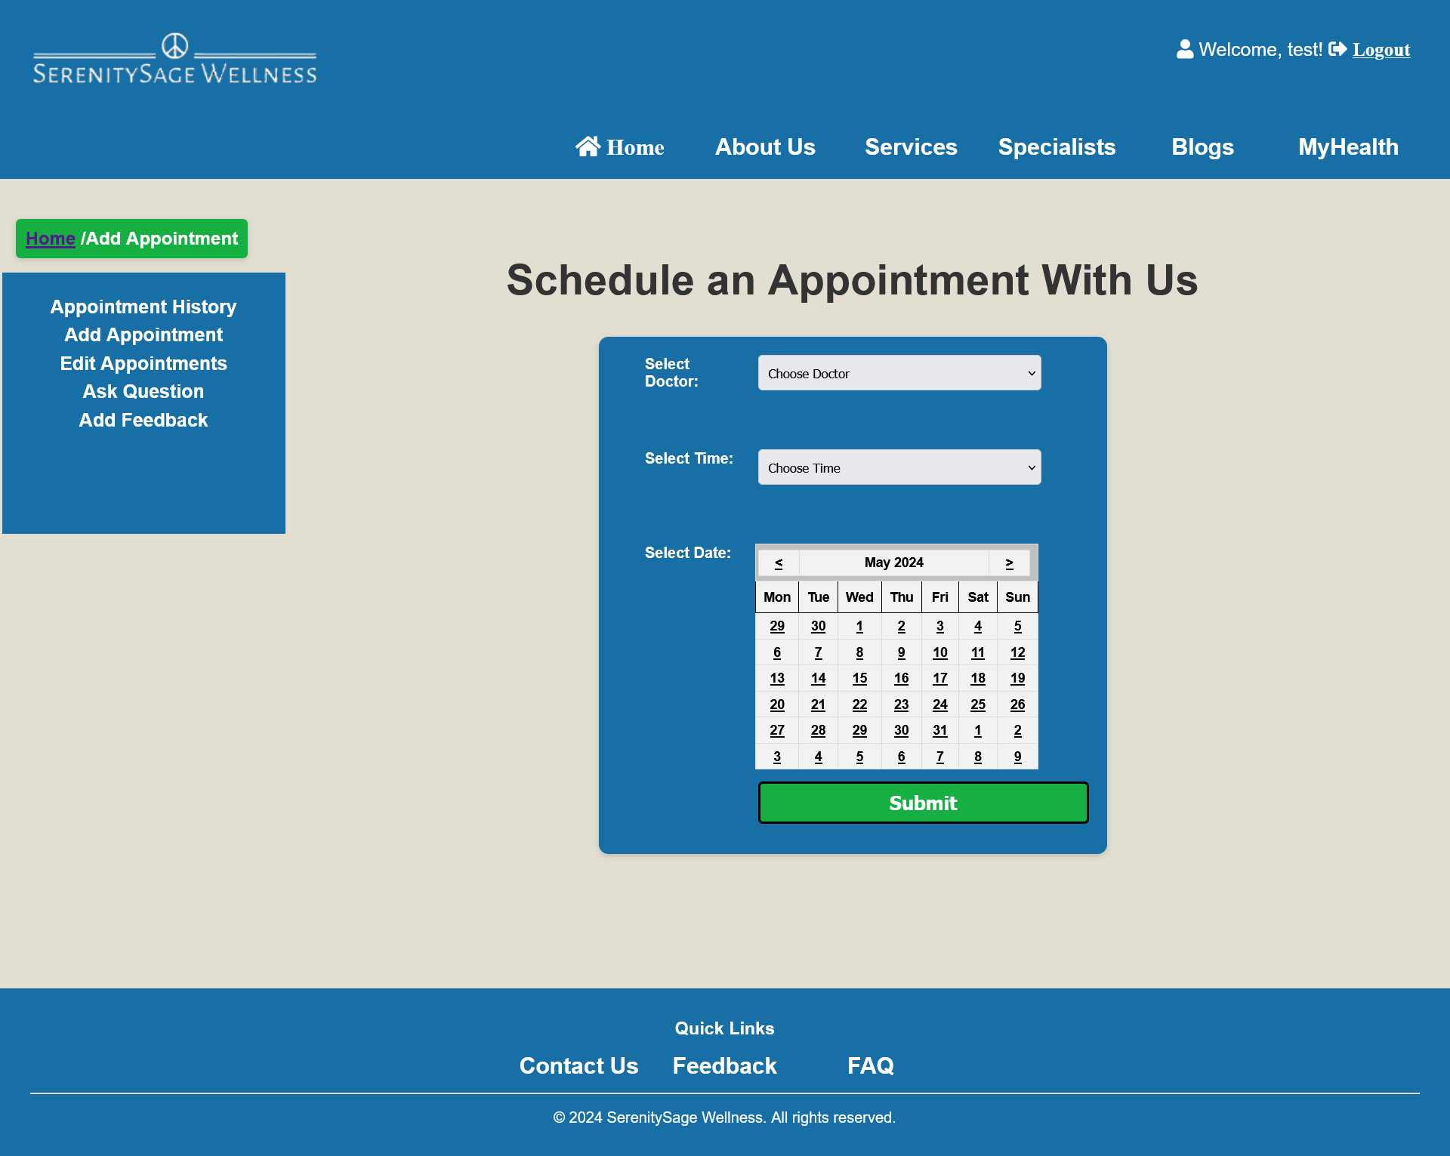
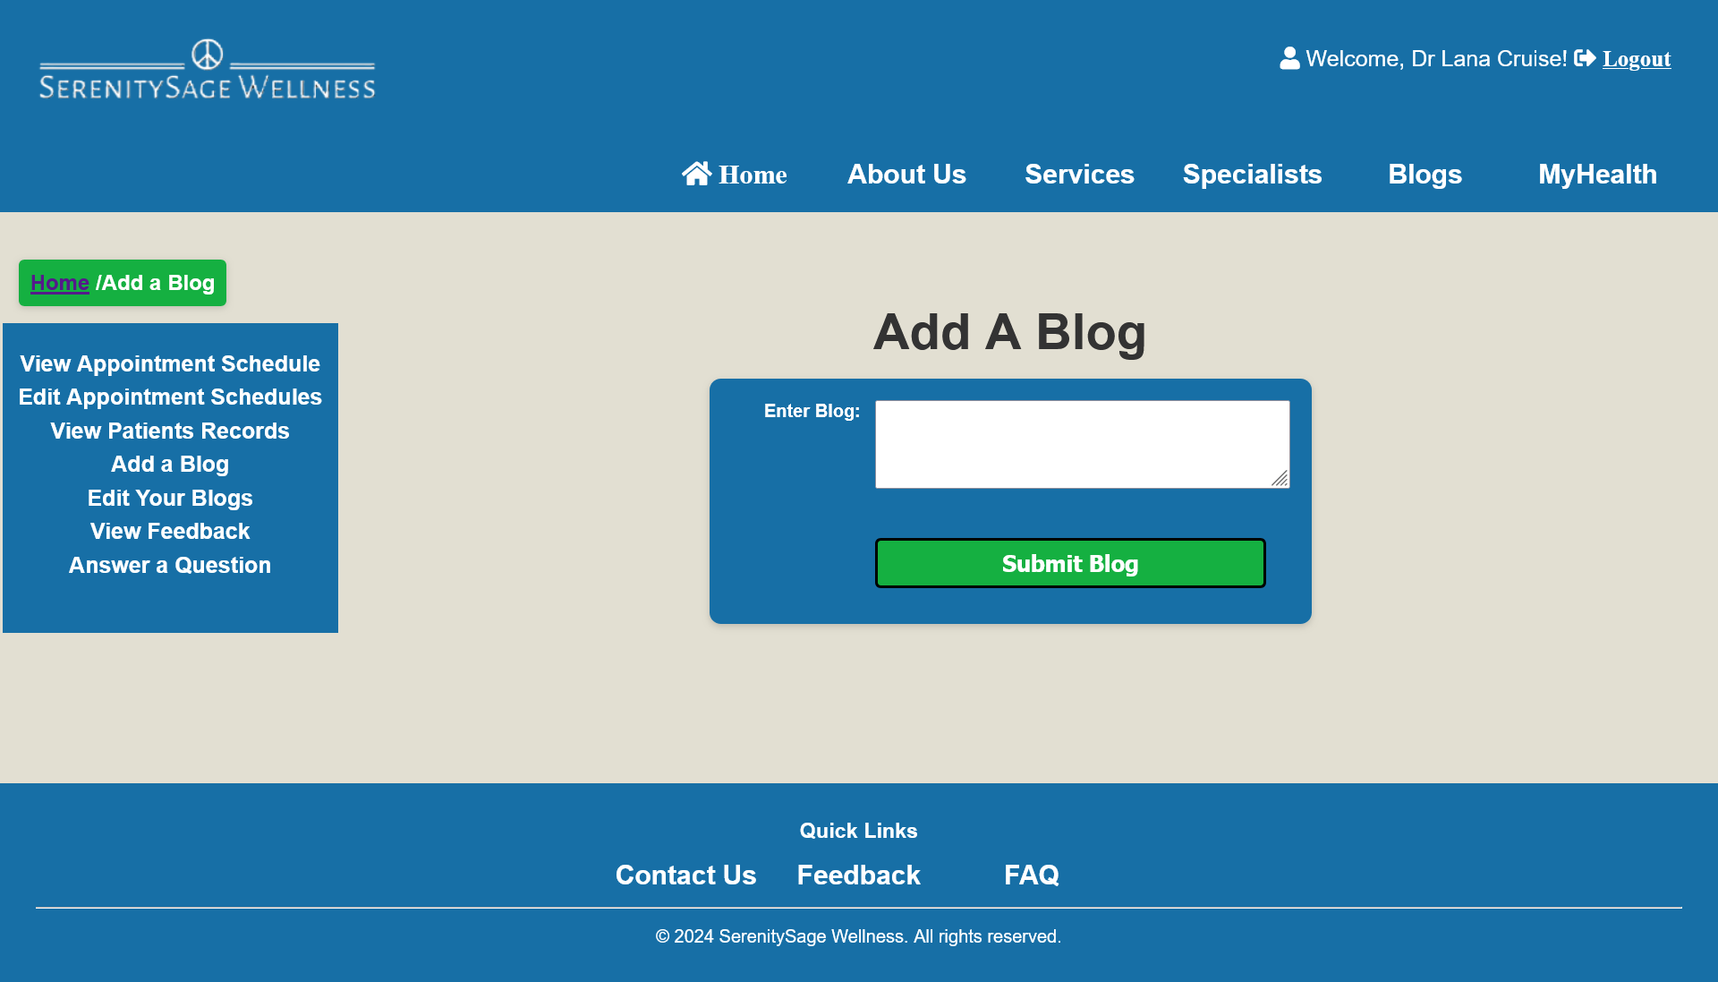
Screenshots

Slide 14
4.3 Left Out Functionality
Payment Feature – Due to a time constraint this feature was not implemented
Search Functionality – A search functionality was attempted to implement. However, due to the complexity of the functionality, it was decided to not include said functionality. Time constraint was another issue that made us step back.

Slide 15
4.4 Security Measures
Secure Login: Implement a secure login process with encrypted passwords
Payment Processing in E-commerce: Use industry-standard payment gateways like PCI-DSS compliance.
Data Encryption: Protects user information like email and contact details.

Slide 16
4.5 Website Security
Data of users can be stolen.
Mitigation strategies:
HTTPS encrypts all communication between browsers and servers, preventing interception of sensitive user information like passwords, credit cards, or personal details as it travels back and forth
Cyberthreats can occur within our websites which will be costly.
Mitigation strategies:
Implement a strong firewall system
Ransomware attacks can encrypt data and disrupt critical healthcare services.
Mitigation strategies: Keep all software and systems up-to-date with the latest security patches and educate staff on identifying and responding to ransomware threats

Slide 17
05
Site Structure

Slide 18
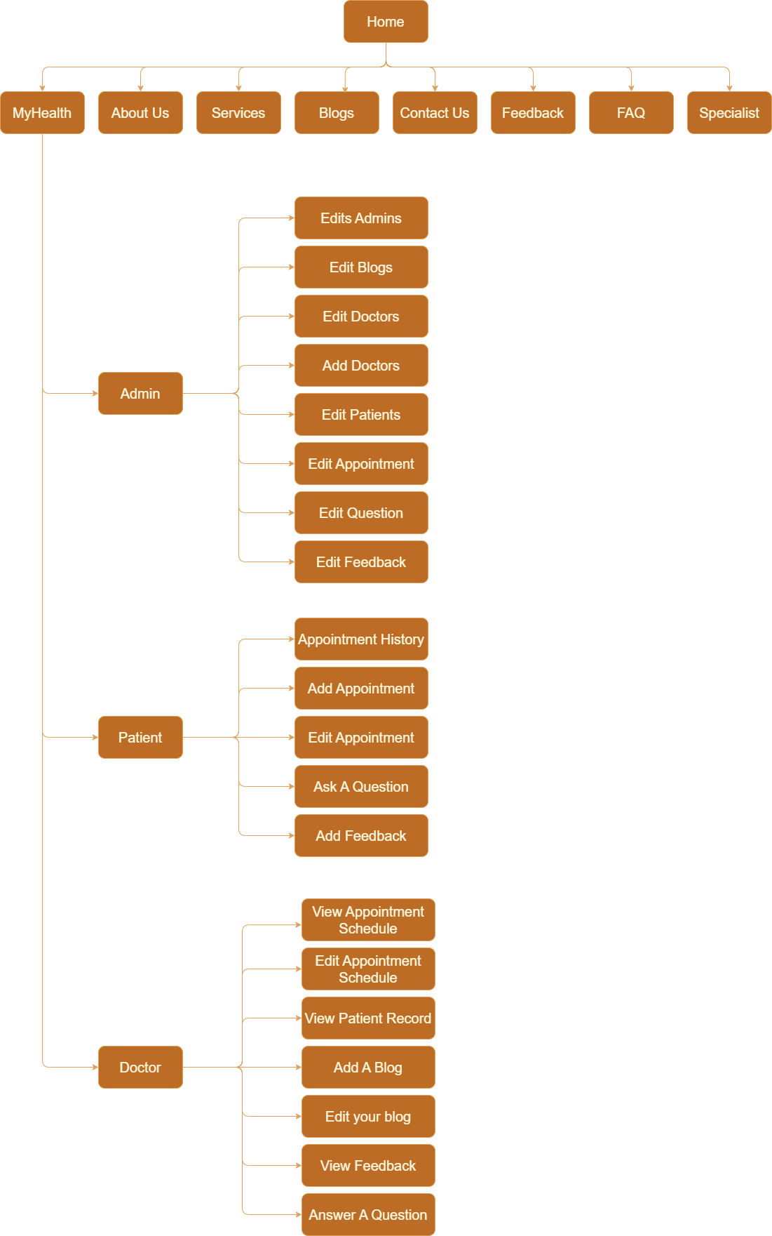
Serenity Sage Wellness uses a hierarchical model as its website architecture. However, a few changes were implemented from the initial design to cater for more content on the site.

Slide 19
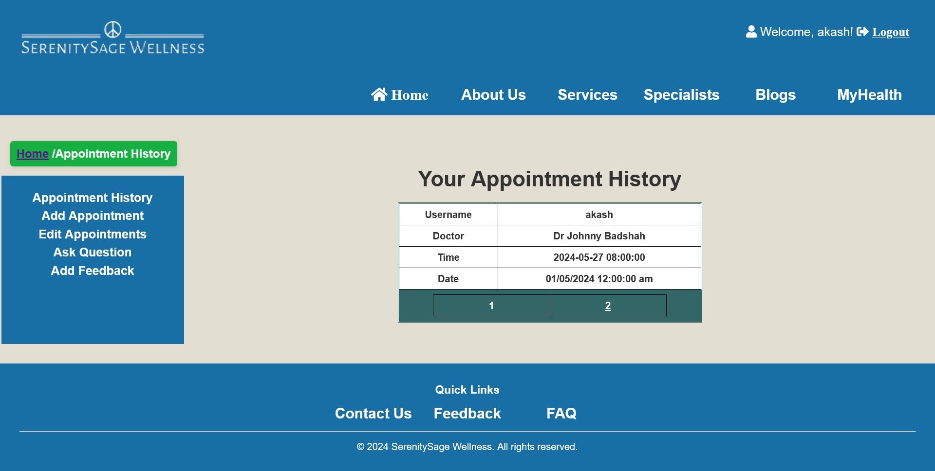
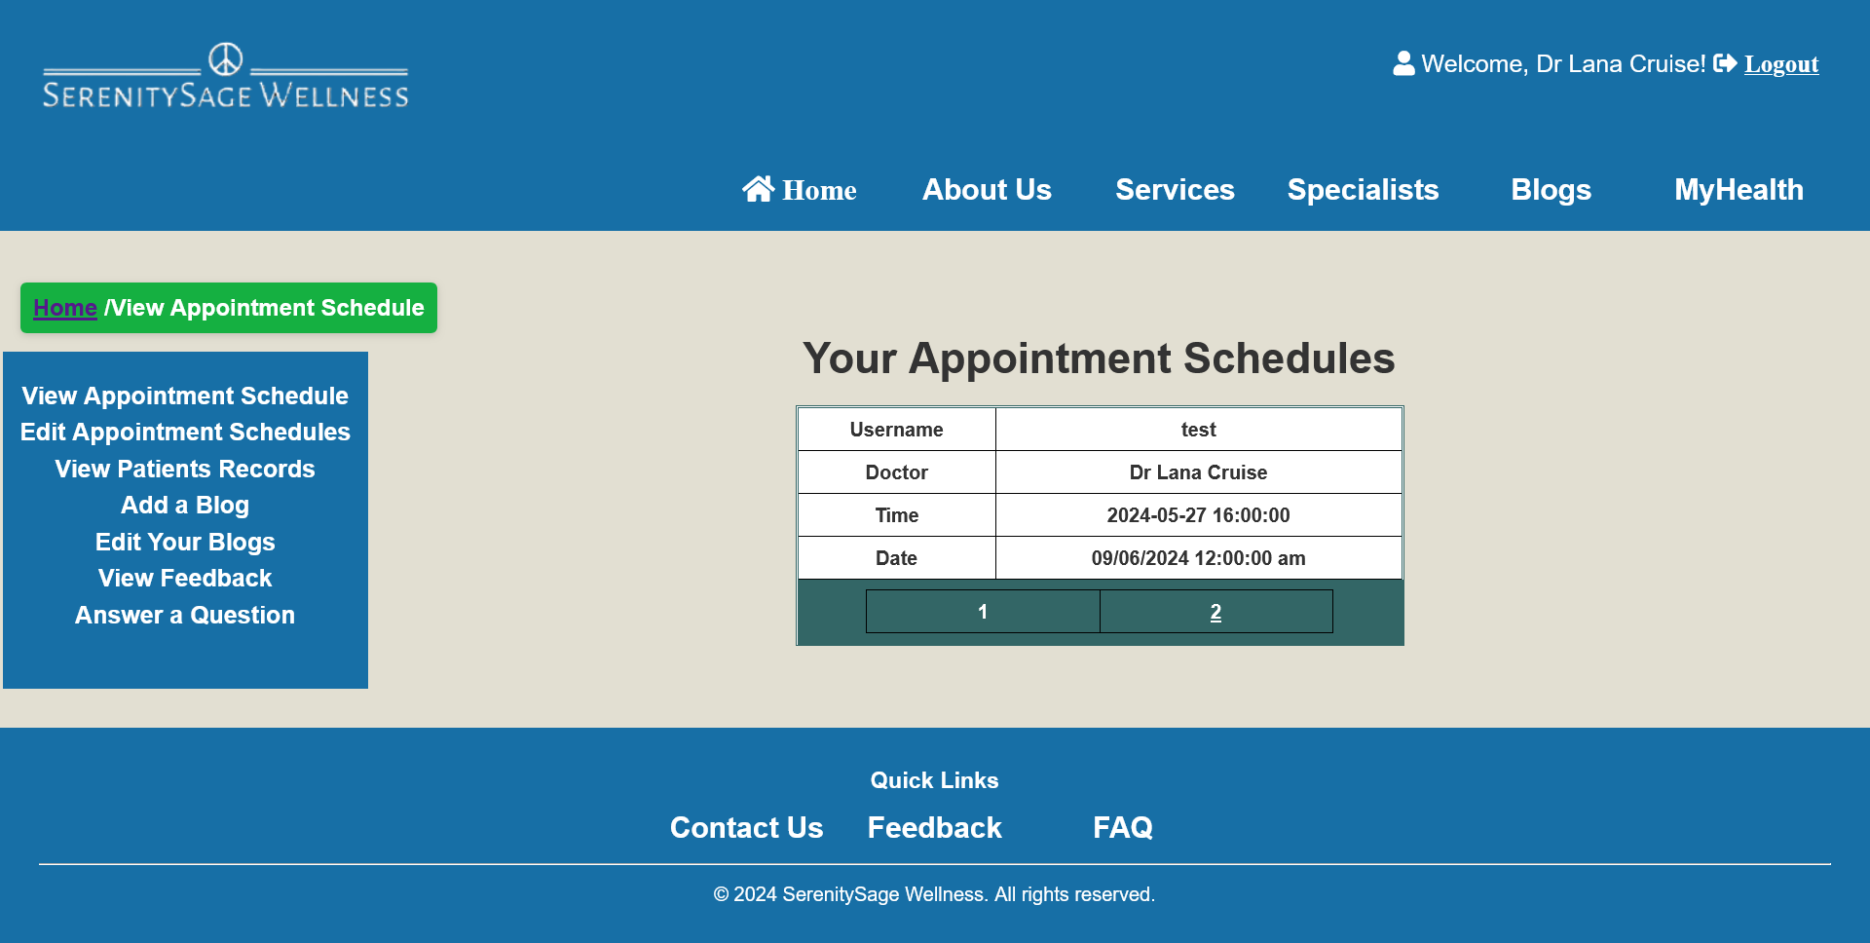
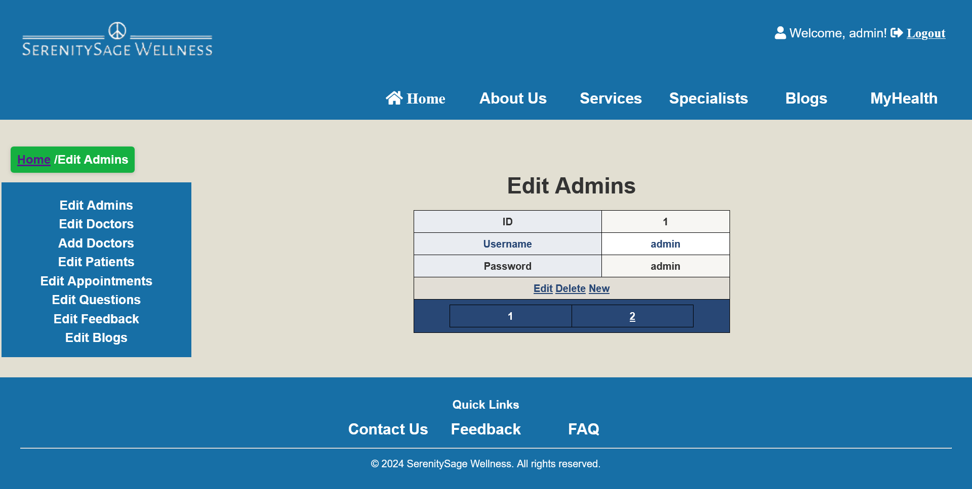
Screenshots

Slide 20
06
Site Navigation

Slide 21
Where Am I?
The title of the page can be viewed by the audience on each page and by also seeing the breadcrumb
Where can I go?
Choosing the contents from the navigation bar. We have followed the “3 click rule”, meaning that the user should get to the desired page within the three clicks.
How do I want to get there?
This can be achieved by clicking on the tabs. This navigation menu can be found at the top of the page.
How do I get back to where I started?
By clicking on the home tab on the top of the web page or the logo which will return the user to their original location or following the breadcrumb.

Slide 22
07
Site Layout

Slide 23
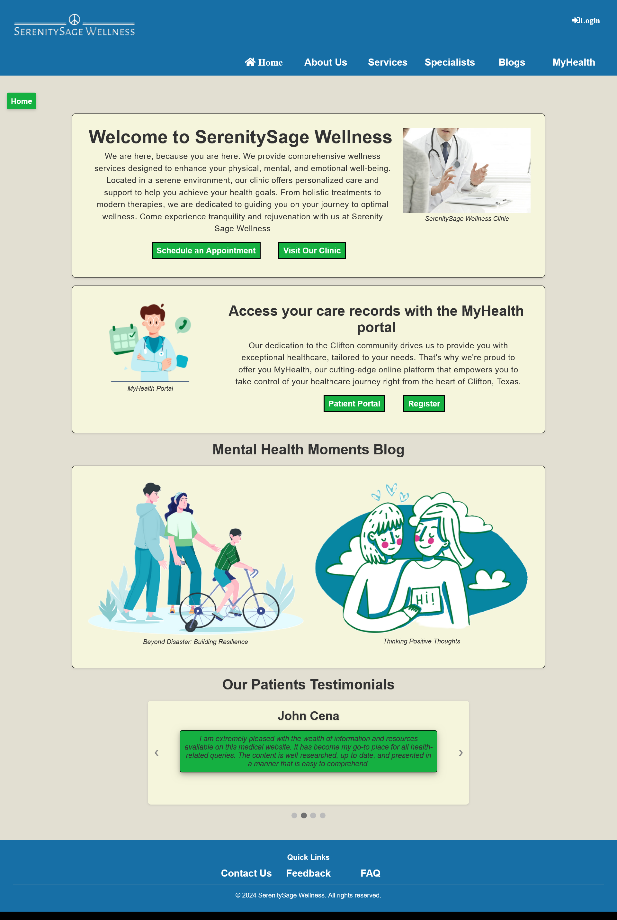
Changes were made to the initial design of the homepage in terms of the content displayed. Reason – After more research and gaining insights, we decided it is better this way in terms of responsive as well. The site has active whitespaces that improves the readability of content

Slide 24
08
Testing

Slide 25
Browsers Used For Testing:
Google Chrome
Microsoft Edge
Firefox
Best Suited Browser: Google Chrome, Firefox
Navigation bar and other contents did not appear properly in the other browsers. Browser cache had to be cleared frequently to see new changes in the styles.

Slide 26
10
Promotional Video:
https://youtu.be/JG-x6K6--_o?si=kSkig8ecIROyvVeE

Slide 27
11
Any Questions?

